Slide 1
Subnetting
Before subnetting:
In any network (or subnet) one can use most of the IP addresses for host addresses.
One loses two addresses for every network or subnet.
Network Address -
Broadcast Address -

Slide 2
Subnet Example
Network address 172.19.0.0 with /16 network mask
Network
Network
Host
Host
172
19
0
0

Slide 3
Subnet Example
Network address 172.19.0.0 with /16 network mask
Network
Network
Host
Host
172
19
0
0
Using Subnets: subnet mask 255.255.255.0 or /24
Network
Network
Subnet
Host
Network Mask: 255.255.0.0 or /16
11111111
11111111
00000000
00000000
Subnet Mask: 255.255.255.0 or /24
11111111
11111111
11111111
00000000
Applying a mask which is larger than the default network mask, will divide your network into subnets.
Subnet mask used here is 255.255.255.0 or /24

Slide 4
Subnet Example
Network address 172.19.0.0 with /16 network mask
Using Subnets: subnet mask 255.255.255.0 or /24
Network
Network
Subnet
Host
172
19
0
Host
Subnets
172
19
1
Host
172
19
2
Host
255 Subnets
2⁸ - 1
172
19
3
Host
172
19
etc.
Host
172
19
254
Host
Cannot use last subnet as it contains broadcast address
172
19
255
Host
What are the subnet address then?

Slide 5
Subnet Example
Network address 172.19.0.0 with /16 network mask
Using Subnets: subnet mask 255.255.255.0 or /24
Network
Network
Subnet
Host
172
19
0
0
Subnets Addresses
172
19
1
0
172
19
2
0
255 Subnets
2⁸ - 1
172
19
3
0
172
19
etc.
0
172
19
254
0
Cannot use last subnet as it contains broadcast address
172
19
255
0

Slide 6
Subnet Example
Class B address 172.19.0.0 with /16 network mask
Using Subnets: subnet mask 255.255.255.0 or /24
Hosts Addresses
Network
Network
Subnet
Hosts
172
19
0
1
254
172
19
1
1
254
172
19
2
1
254
172
19
3
1
254
172
19
etc.
1
254
172
19
254
1
254
Each subnet has 254 hosts, 2⁸ – 2
172
19
255
Host

Slide 7
Subnet Example
Network address 172.19.0.0 with /16 network mask
Using Subnets: subnet mask 255.255.255.0 or /24
Network
Network
Subnet
Host
172
19
0
255
Broadcast Addresses
172
19
1
255
172
19
2
255
255 Subnets
2⁸ - 1
172
19
3
255
172
19
etc.
255
172
19
254
255
Cannot use last subnet as it contains broadcast address
172
19
255
255

Slide 8
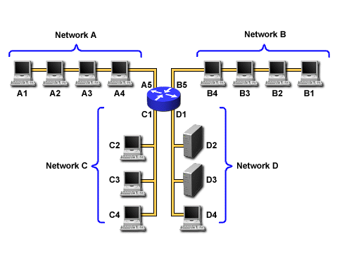
Subnet Example
Network address 172.19.0.0 with /16 network mask
Using Subnets: subnet mask 255.255.255.0 or /24
172.19.0.0/24
172.19.10.0/24
172.19.5.0/24
172.19.25.0/24

Slide 9
Important things to remember about Subnetting
You can only subnet the host portion, you do not have control of the network portion.
Subnetting does not give you more hosts, it only allows you to divide your larger network into smaller networks.
When subnetting, you will actually lose host adresses:
  For each subnet you lose the address of that subnet
  For each subnet you lose the broadcast address of that subnet
  You “may” lose the first and last last subnets
Why would you want to subnet?
  Divide larger network into smaller networks
  Limit broadcasts to their subnet.
  Better management of traffic.

Slide 10
Subnetting – Example
Host IP Address: 138.101.114.250
Network Mask: 255.255.0.0 (or /16)
Subnet Mask: 255.255.255.192 (or /26)
Given the following Host IP Address, Network Mask and Subnet mask find the following information:
Major Network Information
  Major Network Address
  Major Network Broadcast Address
  Range of Hosts if not subnetted
Subnet Information
  Subnet Address
  Range of Host Addresses (first host and last host)
  Broadcast Address
Other Subnet Information
  Total number of subnets
  Number of hosts per subnet

Slide 11
Major Network Information
Host IP Address: 138.101.114.250
Network Mask: 255.255.0.0
Subnet Mask: 255.255.255.192
Major Network Address: 138.101.0.0
Major Network Broadcast Address: 138.101.255.255
Range of Hosts if not Subnetted: 138.101.0.1 to 138.101.255.254

Slide 12
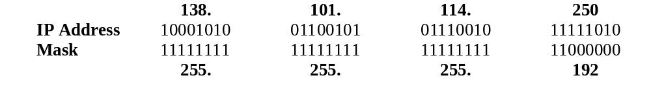
Step 1: Convert to Binary
128 64 32 16 8 4 2 1
Step 1:
Translate Host IP Address and Subnet Mask into binary notation

Slide 13
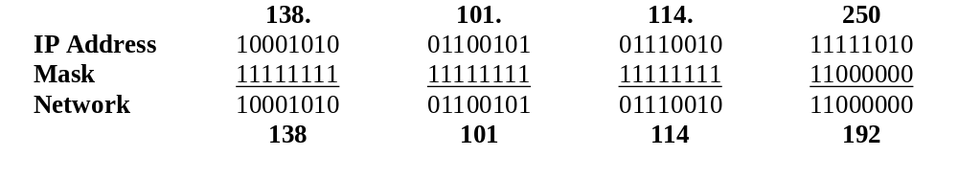
Step 2: Find the Subnet Address
Step 2:
Determine the Network (or Subnet) where this Host address lives:
1. Draw a line under the mask
2. Perform a bit-wise AND operation on the IP Address and the Subnet Mask
Note: 1 AND 1 results in a 1, 0 AND anything results in a 0
3. Express the result in Dotted Decimal Notation
4. The result is the Subnet Address of this Subnet or “Wire” which is 138.101.114.192

Slide 14
Step 2: Find the Subnet Address
Step 2:
Determine the Network (or Subnet) where this Host address lives:
Quick method:
Find the last (right-most) 1 bit in the subnet mask.
Copy all of the bits in the IP address to the Network Address
Add 0’s for the rest of the bits in the Network Address

Slide 15
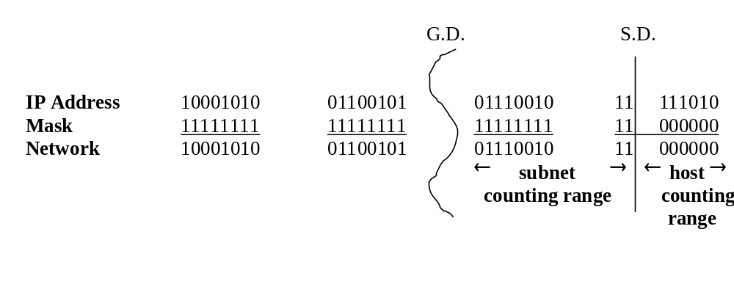
Step 3: Subnet Range / Host Range
Step 3:
Determine which bits in the address contain Network (subnet) information and which contain Host information:
Use the Network Mask: 255.255.0.0 and divide (Great Divide) the from the rest of the address.
Use Subnet Mask: 255.255.255.192 and divide (Small Divide) the subnet from the hosts between the last “1” and the first “0” in the subnet mask.

Slide 16
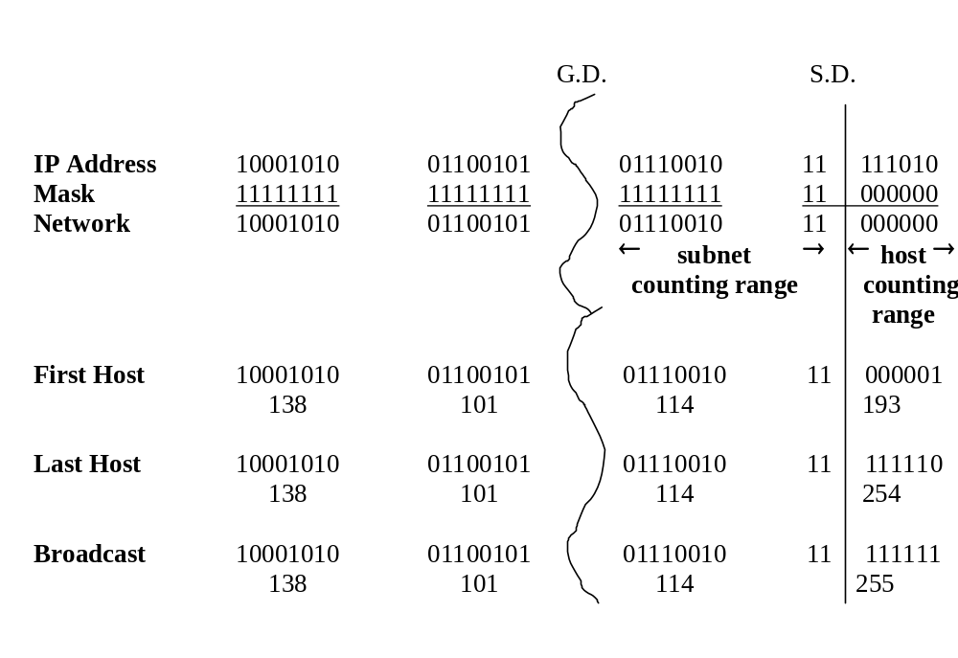
Step 4: First Host / Last Host
Host Portion
Subnet Address: all 0’s
First Host: all 0’s and a 1
Last Host: all 1’s and a 0
Broadcast: all 1’s

Slide 17
Step 5: Total Number of Subnets
Total number of subnets
  Number of subnet bits 10
  2¹⁰ = 1,024
  1,024 total subnets
    Subtract one “if” all-zeros subnet cannot be used
    Subtract one “if” all-ones subnet cannot be used

Slide 18
Step 6: Total Number of Hosts per Subnet
Total number of hosts per subnet
  Number of host bits 6
  2⁶ = 64
  64 host per subnets
    Subtract one for the subnet address
    Subtract one for the broadcast address
  62 hosts per subnet

